Slide 1
DATE
BROWNIE
11/07/2023
TEAM 07
ITERATION02
GITHUB_LINK :
HTTPS://GITHUB.COM/MITTAL-AMAN7/BROWNIE_ASE
PRESENTED BY
Sai Sri Lakshmi Nannapaneni-1002077755
Aman mittal-1001979035
Rukesh Sai kasturi-1002049844
Pavan Sai Akula-1002082165

Slide 2
ERRORS WITH VYPER TESTS
GitHub_Ref[1]: https://github.com/eth-brownie/brownie/issues/1653
The issue reported here is quite specific, relating to the testing of smart contracts written in Vyper using the Brownie framework
To understand Context
Vyper: An alternative language to Solidity for writing smart contracts for the Ethereum blockchain. It aims to be more simple and secure with a syntax like Python.
Ganache: A local blockchain simulator used for Ethereum software development. It allows developers to deploy contracts, develop applications, and run tests.

Slide 3
The Technical Analysis
Central issue: Type conversion failure
The Python int() function threw a TypeError because it was expecting a string input when a base was specified, but it received something else. You can clarify that specifying a base is common when dealing with numerical representations like hexadecimal numbers.
Error message:
TypeError: ‘int() can't convert non-string with explicit base’.

Slide 4
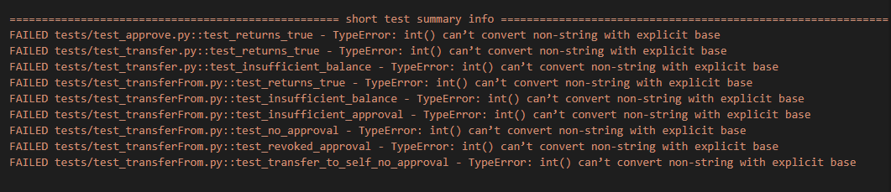
The Technical Analysis
REF-{1}
Error message:
TypeError: ‘int() can't convert non-string with explicit base’.

Slide 5
The Technical Analysis
How the int() Function Works in Python
Expected behavior of int() with base specified.
Hexadecimal base (base=16) as the issue.
In Python, the int() function is used to convert strings or numbers to an integer. When you're working with different numeral systems, like hexadecimal, you need to specify the base for conversion. Normally, int('1A', 16) would convert the hexadecimal string '1A' to the decimal value 26. The issue arose because the function did not receive a string as expected

Slide 6
The Technical Analysis
Mismatched Argument Type
The int() function was given a non-string argument.
step["pc"] = int(step["pc"], 16)
In Python, int(x, base) will convert x to an integer using the given base. If x is not a string, it must be a number, and the base must be omitted. Hence, the error suggests that step["pc"] is not a string when it needs to be. For example, int(1A, 16) would throw an error because 1A is not in quotes to signify a string

Slide 7
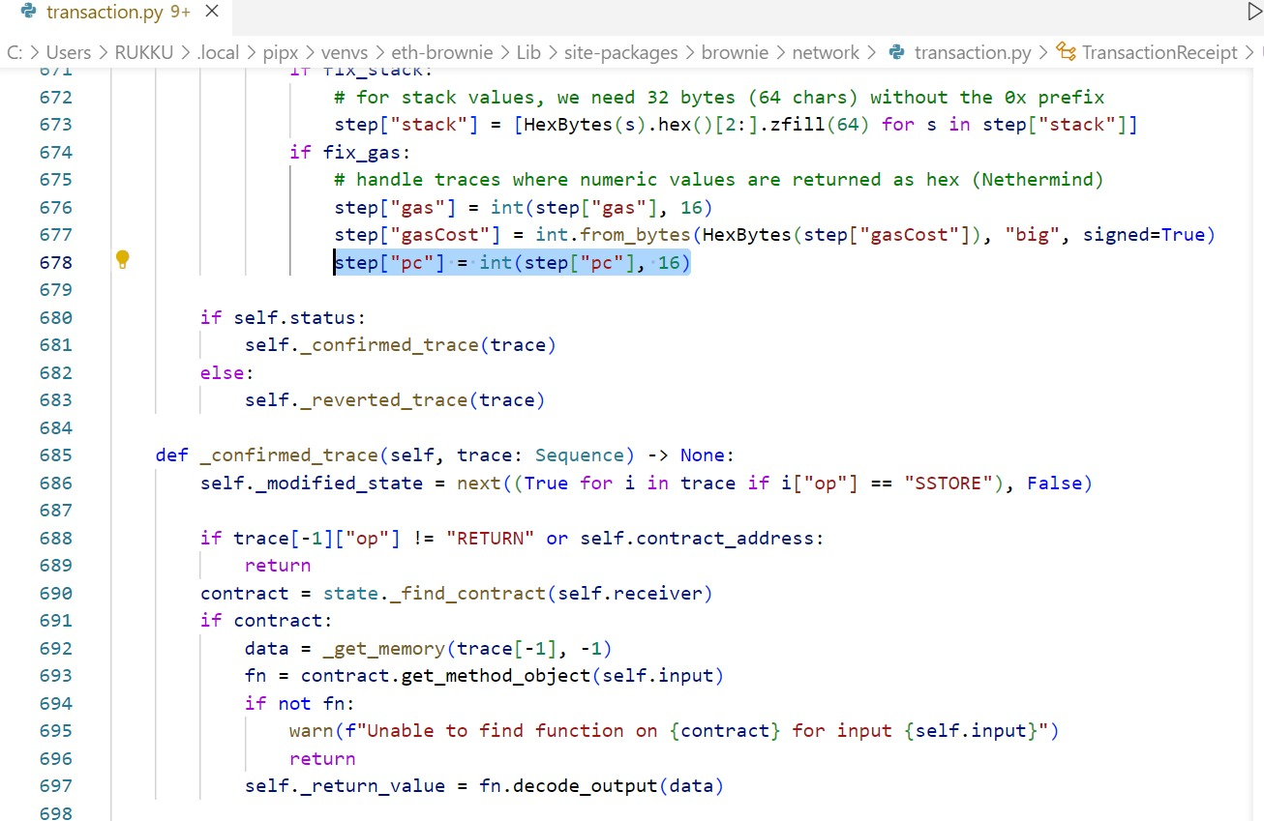
The Technical Analysis

Slide 8
Implemented Solution
Built-in Formatting Function
step["pc"] = int(format(step["pc"], 'x'), 16)
What it does: The format() function is incorrectly applied here; it's meant to format an integer as a hexadecimal string, not to facilitate type conversion.
When to use it: Use format() when you have an integer that you wish to format as a hexadecimal string for display or logging purposes.
Limitation: Misusing format() for type conversion instead of representation can cause errors if step["pc"] is not already an integer

Slide 9
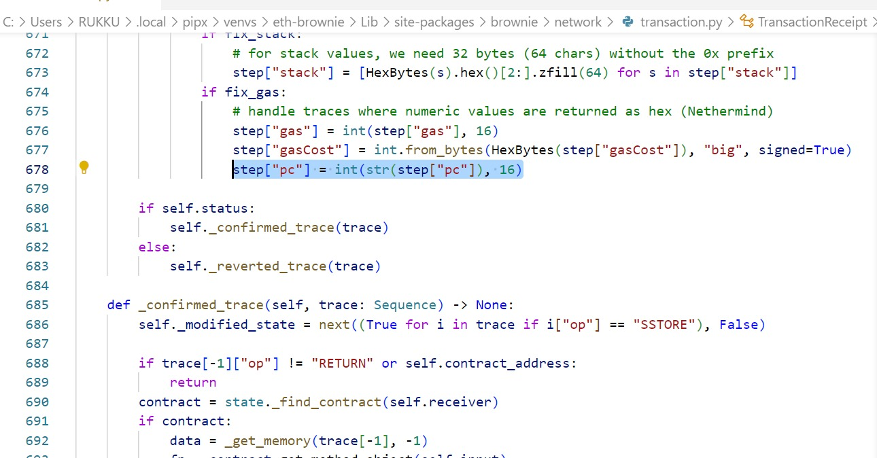
Implemented Solution
Built-in Formatting Function

Slide 10
Suggested Solution Ref[1]
Explicit String Conversion
step["pc"] = int(str(step["pc"]), 16)
What it does: The code ensures step["pc"] is a string before converting it to an integer with hexadecimal base, regardless of its original type.
When to use it: Apply this when a value must be a string to interpret it as a hexadecimal number using int() with a base.
Limitation: This assumes step["pc"] has a meaningful string representation; if not, conversion errors may occur.

Slide 11
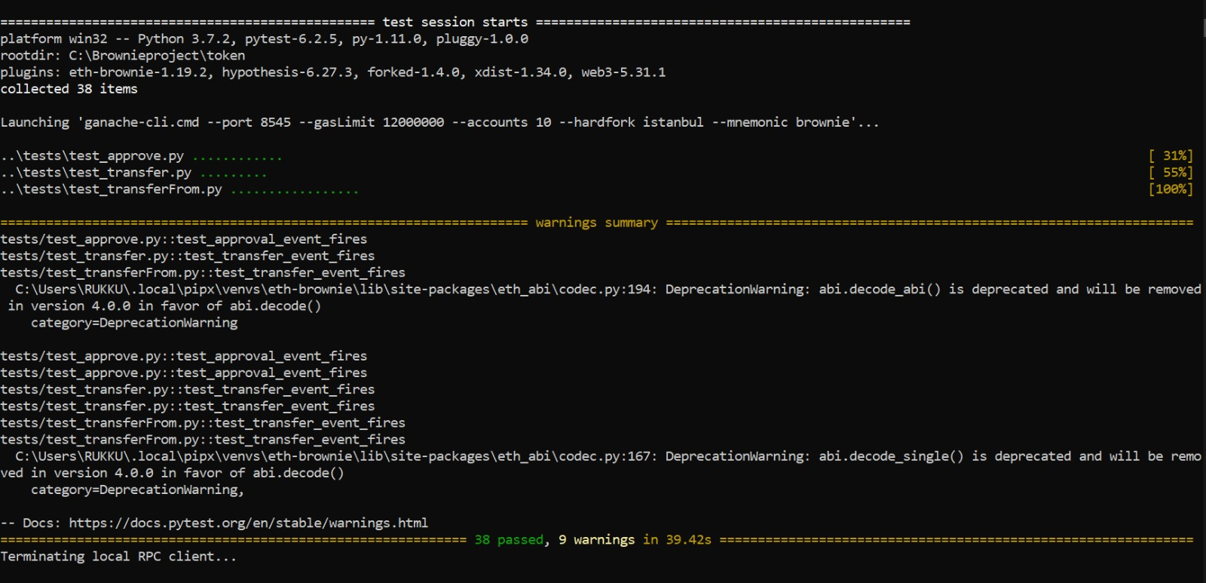
Solution – Passed Tests

Slide 12
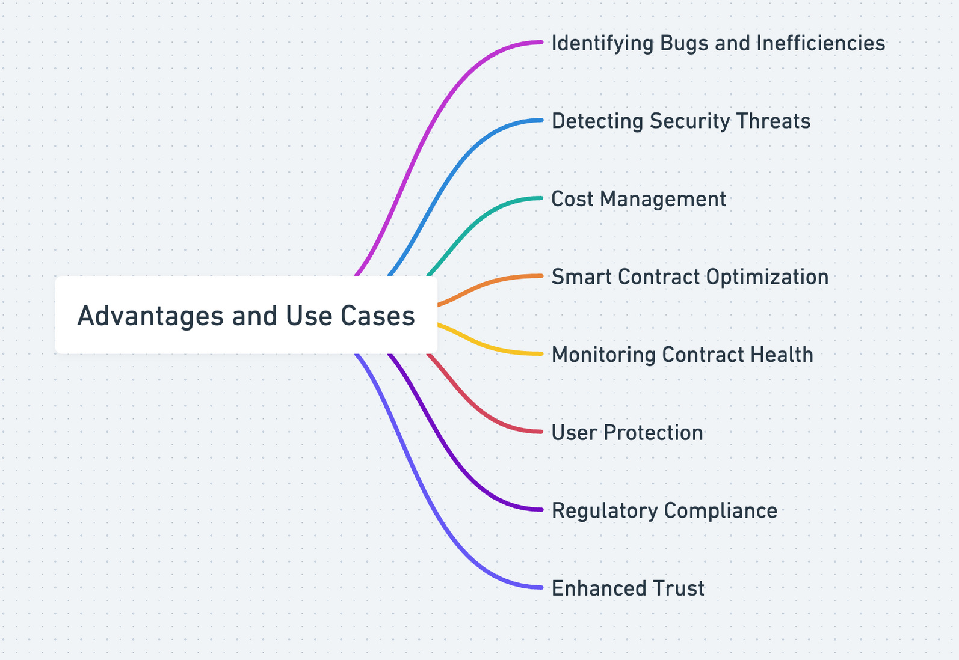
Introduction to Gas Usage Anomaly Detector
Definition: A tool for monitoring gas usage of smart contracts on Ethereum.
Purpose: Alerts for deviations in gas usage patterns indicating bugs, inefficiencies, or security threats

Slide 13
Setting Up the Database
Step 1: Initializing the Data Repository
REF-{9}
SQLite database is created to persistently store transaction data.
The gas_usage table will contain records of transaction hashes, the gas used, and their timestamps.
Python's sqlite3 library is utilized to interact with the SQLite database

Slide 14
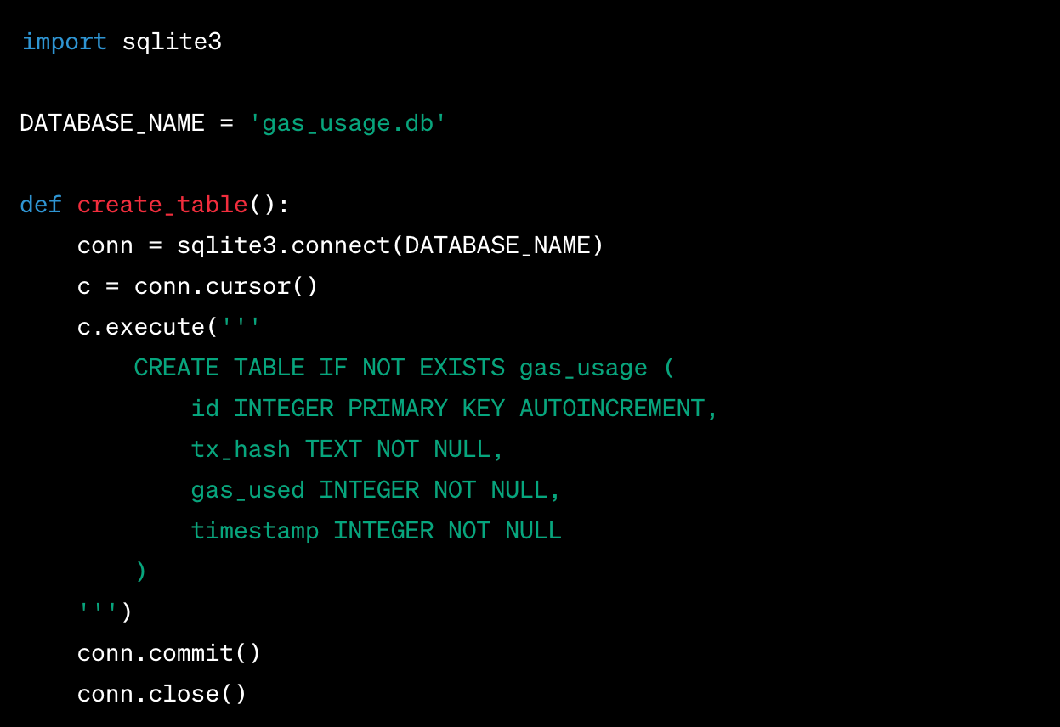
Setting Up the Database
Step 1: Initializing the Data Repository

Slide 15
Data Collection Script
Step 2: Capturing Transaction Data
REF-{10}
The data collection script serves as a bridge between the Ethereum blockchain and our database.
Web3.py is used to connect to the Ethereum network via Infura to retrieve transaction data.
The script filters transactions to the target smart contract and records their gas usage

Slide 16
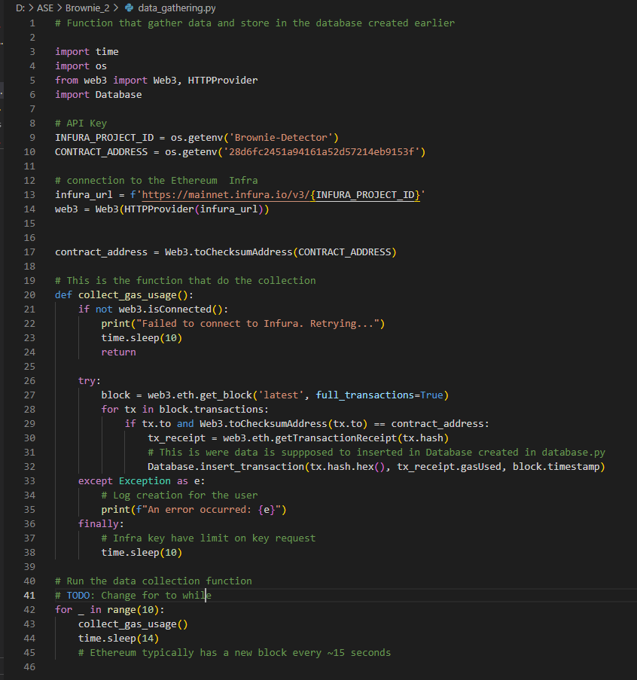
Data Collection Script

Slide 17
Anomaly Detection Script
Step 3: Identifying Outliers in Gas Usage
The anomaly detection script analyzes the recorded data for deviations from the expected gas usage.
A statistical approach is taken, using the standard deviation to flag significant anomalies.
NumPy is used for efficient numerical computation to calculate averages and deviations.

Slide 18
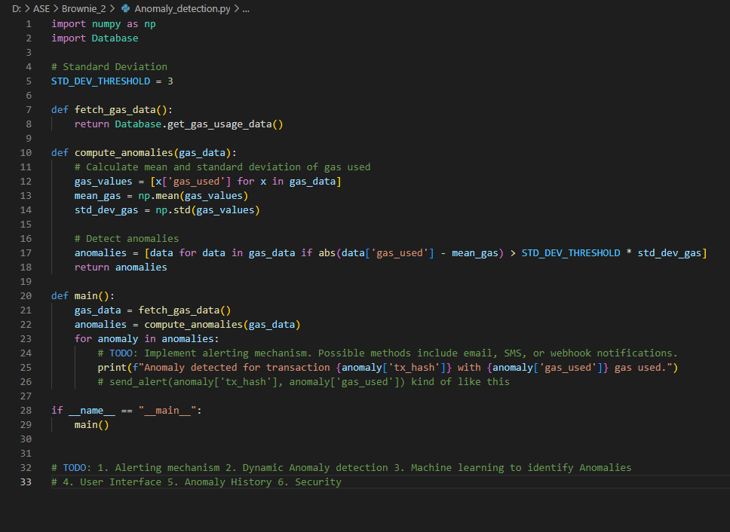
Anomaly Detection Script

Slide 19
Main Execution and Alerting – Work in Progress
Step 4: Automating Detection and Notification
REF-{7, 8}
The main function of the script ties together data collection and anomaly detection.
An alerting mechanism is proposed to notify stakeholders of any detected anomalies.
The actual implementation of the alerting mechanism (e.g., email, SMS, webhook) is to be determined based on the use case

Slide 20
Future Enhancements
Elevating Anomaly Detection:
Database Efficiency: Optimize database queries to handle large datasets and potentially implement caching mechanisms.
Data Validation: Include checks to validate the data before processing to ensure integrity and correctness.
Anomaly History Tracking: Maintain a comprehensive log of past anomalies to inform future detection and to understand the temporal patterns.
Security Improvements: Enhance data protection measures and secure communication channels to safeguard sensitive transaction information.

Slide 21
Risk Mitigation Strategies
Implement advanced algorithms and machine learning.
Refine detection thresholds based on data.
Secure data processes and comply with privacy laws.
Plan scalability and resource management.
Update with Ethereum network changes.

Slide 22
Tools and Technologies
CATEGORY | Tools and Technologies
Web3 Libraries | Web3.js , Ether.js
Data Storage | SQLite, inFuture : MongoDB
Backend Framework | Flask
Front-end Framework | React
APIs for Alerting | Email services , Communication Platforms

Slide 23
REFERENCES
https://github.com/eth-brownie/brownie/issues/1653
https://docs.vyperlang.org/en/v0.2.14/testing-contracts-brownie.html
https://eth-brownie.readthedocs.io/en/stable/tests-pytest-intro.html
https://k0nze.dev/posts/python-estimate-ethereum-gas/
https://ethereum.stackexchange.com/questions/27452/how-to-estimate-gas-cost
https://www.sciencedirect.com/science/article/pii/S2096720923000234
https://www.youtube.com/watch?v=UISu1jFJOGc
https://www.youtube.com/watch?v=ceGCPVH6PNQ

Slide 24
REFERENCES
https://docs.python.org/3/library/sqlite3.html
https://moralis.io/python-and-web3-a-web3-and-python-tutorial-for-blockchain-development/

Slide 25
THANK YOU!
TEAM 07

